Slide 1
Processing and Analysing Data
DPDD Occupational Specialism ​
Week 18

Slide 2
Learning outcomes
By the end of Monday, students will be able to:
Clean and structure a survey dataset in Excel and compute Top‑2/Bottom‑2 box, means, and dispersion per item and group.
Build PivotTables and create a diverging Likert stacked bar chart to communicate results.
Apply Braun & Clarke’s six phases to develop a defensible theme framework from item wording (and any comments, if present).
Combine quant and qual via a joint display (themes × key metrics) and write a concise, evidence‑based conclusion with limitations and next steps.

Slide 3
First Impressions
Open the dataset and explore:
number of rows
variables available
what each column means
response range
anything that looks unusual or interesting
Notes:
What do you notice about the pattern of responses at first glance?
What is the dataset about?

Slide 4
What Is Quantitative Data?
numerical values that can be counted, averaged, or compared
used to identify trends and patterns
allows clear, evidence‑based decision-making
Examples in this dataset:
Answer_Numeric (0–4)
Year (2019–2021)
Role, Department (categorical → grouped summaries)

Slide 5
Likert Scales
A Likert scale measures attitudes using set response points.
Our scale: 0–4
0 = Not applicable
1 = Strongly disagree
2 = Disagree
3 = Agree
4 = Strongly agree
Why it matters:
supports frequency counts
supports averages and medians
enables Top‑2 / Bottom‑2 agreement analysis

Slide 6
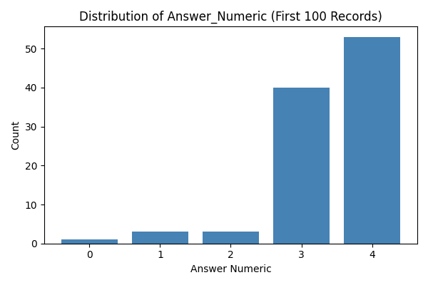
Distributions
A distribution shows how values spread across response categories.
Useful for detecting:
skew (lots of high or low scores)
outliers
central tendency (mode, median)
In engagement surveys, skew towards high scores is common.
Most answers fall in the 3–4 range, showing strong agreement.
Very few responses fall into the lower categories (1–2).
This creates a positive skew, which is typical for engagement surveys.
The mode is 4, meaning Strongly Agree is the most common rating.
The median is 3, showing the central response is Agree.
Outliers (0s, 1s) may indicate pockets of dissatisfaction or missing data.

Slide 7
Dataset Overview
Years: 2019, 2020, 2021
Roles: Staff, Supervisor, Manager, Lead, Director
Departments: multiple operational and corporate teams
One core question: “I know what is expected of me at work.”
Numeric responses 0–4
Synthetic free‑text comments (not used yet)

Slide 8
Frequency Tables
Frequency tables show how often each response occurs.
Useful for:
identifying dominant responses
preparing for bar charts or histograms
checking data quality
Answer_Numeric | Count
0 | 1
1 | 3
2 | 3
3 | 40
4 | 53

Slide 9
Build a Frequency Table
Use answer_numeric
Count how many times each appears (COUNTIF)
Build a bar chart from it
Use the Excel formulas sheet to help you.
Which response is most common?
Are there many low scores?
Does the distribution look skewed?

Slide 10
Top‑2 and Bottom‑2
Top‑2 Box = % choosing 3 or 4
Bottom‑2 Box = % choosing 1 or 2
Why used:
simplifies interpretation
focuses on “positive vs negative sentiment”
allows comparisons across groups regardless of sample size

Slide 11
Weighting rules
Strongly agree (4) → +2
Agree (3) → +1
Disagree (2) → –1
Strongly disagree (1) → –2
0 values (N/A) are excluded from weighting

Slide 12
Pivot table
PivotTables summarise data by categories.
Useful for:
comparing groups (departments, roles, years)
identifying where scores differ
spotting potential areas for investigation

Slide 13
Average Score by Department
Steps:
Insert PivotTable
Rows → Department
Values → Average of Answer_Numeric
Prompts:
Which departments score highest?
Any departments consistently lower?
Does the pattern make sense?
Try it with the full dataset (>130k rows)

Slide 14
Average Score by Role
Steps:
Insert PivotTable
Rows → Role
Values → Average of Answer_Numeric
Prompts:
Do supervisors/managers score higher than staff?
Does responsibility level affect agreement?
Try it with the full dataset (>130k rows

Slide 15
Bringing It Together (Synthesis)
Produce 3 short insights:
One about distributions
One about group differences (role or department)
One about trends or Top‑2
Insights must:
be factual
be based on evidence
avoid assumptions

Slide 16
Quantitative analysis in Excel
Monday

Slide 17
Qualitative Data
Plain‑language statements written by individuals
Express views, perceptions, concerns, frustrations, or suggestions
Not structured; vary in clarity, tone, length
Provide context that the numbers alone cannot reveal

Slide 18
Thematic analysis using Braun & Clarke
Monday

Slide 19
Introduction to Thematic Analysis
The Goal: To move beyond just reading comments to identifying patterned meanings (themes) across the whole dataset.
Method: Braun and Clarke’s Reflexive Thematic Analysis.
Why this? It is flexible and allows us to understand the "why" behind your engagement scores.
The Data: We are focusing on the Improvement_Comments column (e.g., feedback on communication, leadership, and support).

Slide 20
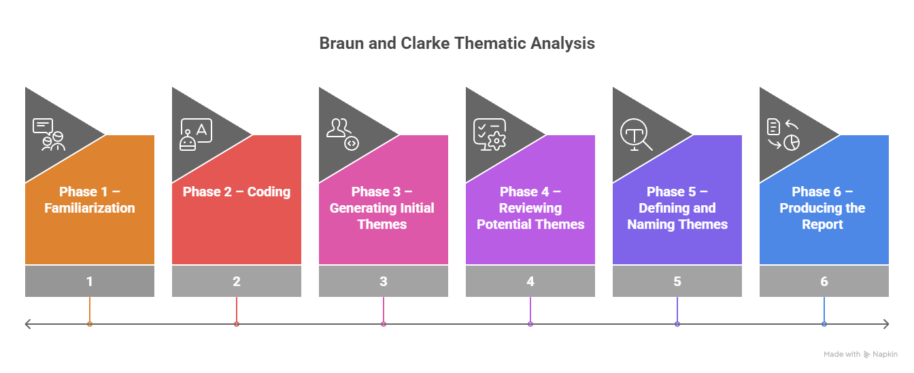

Slide 21
Phase 1 – Familiarisation
Don’t start analysing yet. Just read.
The Task: Read every comment in the CSV. Do not take notes yet; just immerse yourself in the "voice" of the employees.
HR Data Example: You’ll notice patterns emerging early—words like "transparency," "leadership," and "timing" appear frequently.
Pro Tip: Even if you think you know what the issues are, read them all again to spot outliers or surprising perspectives.

Slide 22
Phase 2 – Coding
Labelling the building blocks.
The Task: Go through the data line-by-line and assign a short "code" to describe what is being said.
Application to your data:
"Important information often arrives too late" Code: Poor Timing.
"Leadership expectations feel unclear" Code: Role Ambiguity.
"Good work is not always recognised" Code: Lack of Recognition.
Note: One comment can have multiple codes.

Slide 23
Phase 3 – Generating Initial Themes
Organizing codes into groups.
The Task: Look at your long list of codes and cluster them into "candidate themes."
The Transition:
Codes: Poor Timing, Lack of Transparency, Unclear Updates.
Potential Theme: "Communication Gaps."
Codes: Inconsistent Support, Unclear Expectations.
Potential Theme: "Management Consistency."

Slide 24
Phase 4 – Reviewing Potential Themes
Quality control.
The Task: Check your themes against the original data.
Ask Two Questions:
Do the codes within a theme actually fit together? (Internal Homogeneity)
Is there a clear distinction between Theme A and Theme B? (External Heterogeneity)
Example: If "Communication Gaps" and "Management Consistency" are basically the same thing in this data, merge them.

Slide 25
Phase 5 – Defining and Naming Themes
Finding the "Story."
The Task: Write a "scope" for each theme. What does it cover, and what does it not cover?
Refining the Names: Move from descriptive to interpretive.
Instead of: "Communication."
Try: "The Information Void" (Capturing the feeling that employees are being left in the dark).
Action: Select the most "telling" quotes from the spreadsheet to represent each theme.

Slide 26
Phase 6 – Producing the Report
Linking data to decisions.
The Task: Tell the story of your data.
Structure:
The Theme: State it clearly.
The Evidence: Use the specific quotes (e.g., "Decisions are not always communicated transparently").
The Context: Relate it to the quantitative scores (e.g., why "Opinions Count" scored a 3/5).
End Goal: Provide the organisation with actionable insights, not just a list of complaints.

Slide 27
Writing conclusions
Monday

Slide 28
Synthesizing the Main Themes
The "Final Stretch" of your Analysis
You have coded your data and identified your themes. Now, you need to tell the reader what this actually means for the organisation.
The Goal of your Conclusion:
Summarise: What is the "big story" in the data?
Connect: How do the comments explain the engagement scores?
Recommend: Based on these stories, what should the organisation change?

Slide 29
Task 1 – The "Big Story"
Synthesizing your Themes
Don’t just list your themes; tell us how they interact. Use these starters to begin your concluding paragraphs:
"Across the 100 comments analysed, the most pervasive pattern identified was..."
"While feedback varied across roles (Managers vs. Staff), a consistent narrative emerged regarding..."
"The thematic analysis revealed that employee engagement is heavily influenced by [Theme A] and [Theme B]."

Slide 30
Task 2 – Bridging the Gap
Connecting Stories to Numbers
In your spreadsheet, you have "Agree/Disagree" scores and written comments. Your job is to use the comments to explain the numbers.
"The discrepancy between the high 'Role Clarity' scores and the specific comments regarding [Theme Name] suggests that..."
"The data suggests that the 'Agree' scores in the survey mask a deeper concern regarding..."
"Participant comments, such as [Insert a key quote here], indicate that the current approach to communication is perceived as..."

Slide 31
Task 3 – The "So What?"
Interpreting the Findings
Go deeper. Why does this matter for the workplace culture?
"The prevalence of [Theme] suggests that the underlying issue is not a lack of resources, but rather a breakdown in..."
"These findings imply that for employees to feel their 'opinions count,' the organization must first address..."
"The data indicates a tension between [Theme A] and [Theme B], which may be driving the partial completion rates seen in the data."

Slide 32
Task 4 – Actionable Advice
What should the organisation do tomorrow?
The best qualitative research leads to change. Use these starters to frame your recommendations:
"To address the 'Information Void' identified in the analysis, leadership should prioritise..."
"Based on the thematic finding of [Theme Name], a primary recommendation for the [Department name] department is to..."
"Future engagement strategies should move beyond general updates and instead focus on fostering..."

Slide 33
The "Conclusion Formula"
Stuck? Use this 4-Sentence Structure:
The Big Picture: Overall, this analysis shows that [Main Theme] is the primary driver of current sentiment.
The Proof: This is evidenced by the high frequency of codes related to [Code X] and [Code Y].
The Meaning: This suggests that employees feel [Interpret the feeling—e.g., undervalued or disconnected].
The Action: Therefore, the department should focus on [Specific Action] to improve future engagement.

Slide 34
Checklist for a Strong Conclusion
[ ] Did I mention at least two of my key themes?
[ ] Did I use a specific quote from the spreadsheet to back up my point?
[ ] Did I explain why these themes are appearing (the "underlying cause")?
[ ] Did I offer a solution that HR could actually implement?

Slide 35
Thursday Project

Slide 36
Pair Analysis

Slide 37
MediHealth app feedback analysis
In a pair, analyse the data from MediHeath
Remember to look at all the questions.
Use the detail from the conclusions section from Monday to help with the final conclusions.
Upload to Teams

Slide 38
Individual Analysis

Slide 39
Analyse one of your sets
Using the survey sets you generated last week, analyse and write a conclusion.
Upload to Teams

Slide 40
Friday Feedback

